Slide 1
Facial Recognition using Convolutional Neural Network
SUBMITTED BY:
MUDITA SHARMA (48513302816)
IRA SHARMA (47013302816)

Slide 2

♣
A biometric is a unique, measurable characteristic of a human being that can be used to automatically recognize an individual or verify an individual’s identity.
♣
Biometrics can measure both physiological and behavioral characteristics.
Physiological biometrics:- This biometrics is based on measurements and data derived from direct measurement of a part of the human body.
Behavioral biometrics:- this biometrics is based on measurements and data derived from an action.
♣
♣

Slide 3
Types Of Biometrics
PHYSIOLOGICAL BEHAVIORAL
Finger-scan
Facial Recognition
Iris-scan
Retina-scan
Hand-scan
Voice-scan
Signature-scan
Keystroke-scan

Slide 4
Facial Recognition ???
♣
It requires no physical interaction on behalf of the user.
It is accurate and allows for high enrolment and verification rates.
♣
♣
It can use
your existing
existing hardware camaras and image
infrastructure,
capture Devices will work with no problems

Slide 5

Dataset

Slide 6
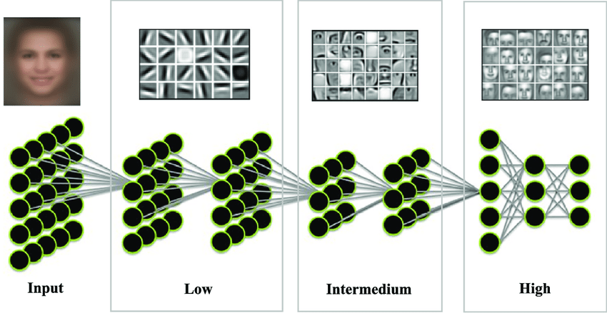
Working

Slide 7
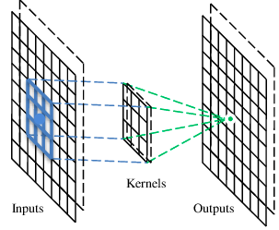
A convolutional layer
A CNN is a neural network with some convolutional layers
(and some other layers). A convolutional layer has a number
of filters that does convolutional operation.
A filter

Slide 8
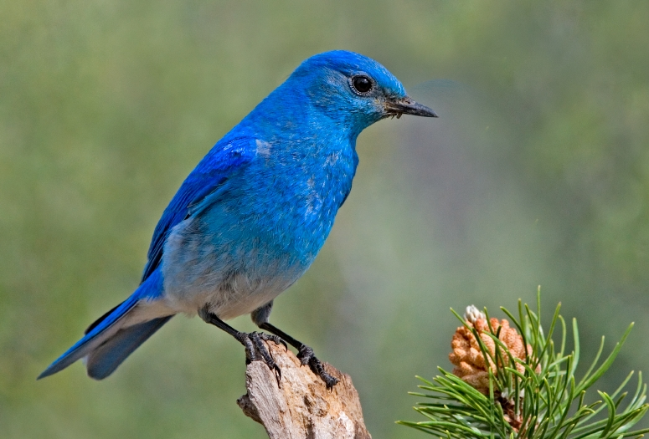

Why Pooling
Subsampling pixels will not change the object
bird
bird
Subsampling
We can subsample the pixels to make image smaller
fewer parameters to characterize the image

Slide 9
Max Pooling
New image
but smaller
1 | 0 | 0 | 0 | 0 | 1
0 | 1 | 0 | 0 | 1 | 0
0 | 0 | 1 | 1 | 0 | 0
1 | 0 | 0 | 0 | 1 | 0
0 | 1 | 0 | 0 | 1 | 0
0 | 0 | 1 | 0 | 1 | 0
Conv
3
0
-1
1
Max
Pooling
3
1
0
3
2 x 2 image
6 x 6 image
Each filter
is a channel

Slide 10
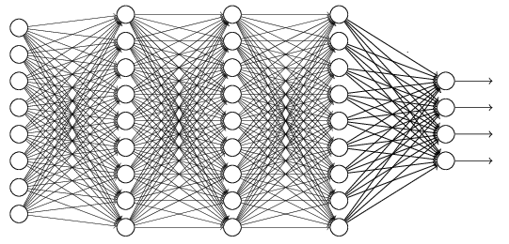
Flattening
3
0
1
3
0
-1
1
3
3
1
-1
0
3
Flattened
1
Fully Connected Feedforward network
0
3

Slide 11
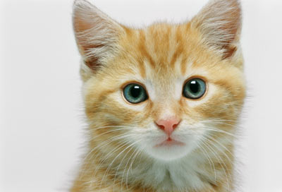
The whole CNN
cat dog ……
Convolution
Max Pooling
Fully Connected Feedforward network
A new image
Convolution
Max Pooling
Flattened
A new image

Slide 12
Applications
♣
Security/Counterterrorism. Access control, comparing surveillance images to Know terrorist.
Day Care: Verify identity of individuals picking up the children.
♣
♣
Residential Security: Alert homeowners of
approaching personnel
♣
Voter verification: Where eligible politicians are required to verify their identity during a voting process this is intended to stop voting where the vote may not go as expected.
Banking using ATM: The software is able to quickly verify a customer’s face.
♣

Slide 13
Conclusion
•
Factors such as environmental changes and mild changes in appearance impact the technology to a greater degree than many expect.
For implementations where the biometric system must verify and identify users reliably over time, facial scan can be a very difficult, but not impossible, technology to implement successfully.
•

Slide 14
Thank You…

